Slide 1


Workshop 02:
Data Visualization with ggplot2
Oct.22 2021

Slide 2
Agenda
Introduction: ggplot2
Data visualization foundation: Gestalt principle
How to visualize different types of data with ggplot2

Slide 3
Introduction:
ggplot2

Slide 4

Where does ggplot2() come from?
“I truly can’t imagine what my life would be like without the success of ggplot2.”
--Wickham
A portrait of ggplot2 creator Hadley Wickham
Notes:
It is really helpful if near the start of the talk when talking through the major parts of ggplot and ggplot2 is to talk through the different settings and assumptions. The ? for each one gives a ton of data, as do the CRAN manual pages (you can search online for these). for example, the aes() settings are extensive, and so talking through the intention of how aes() works, why it works the way it does (the readings talk about this), and what the options are, is really helpful for the class.

Slide 5
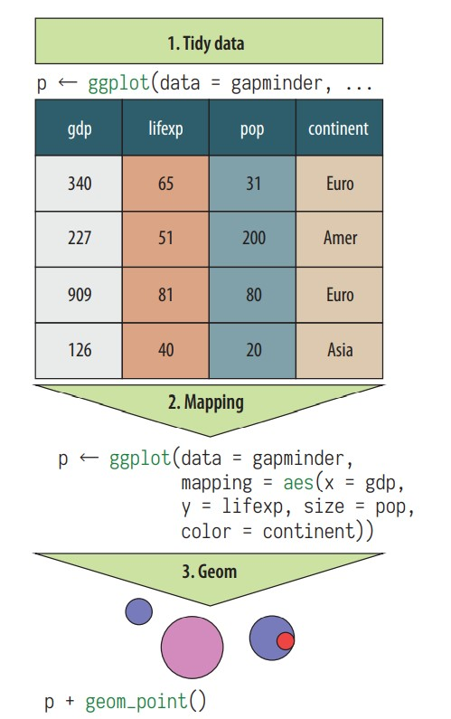
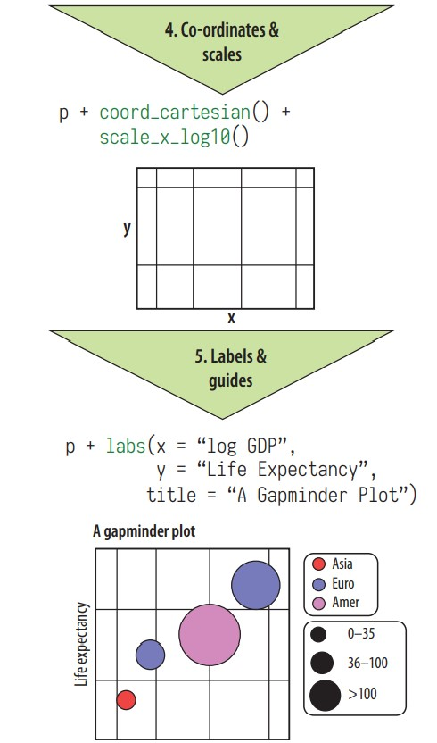
Healy, K(2017)

Slide 6
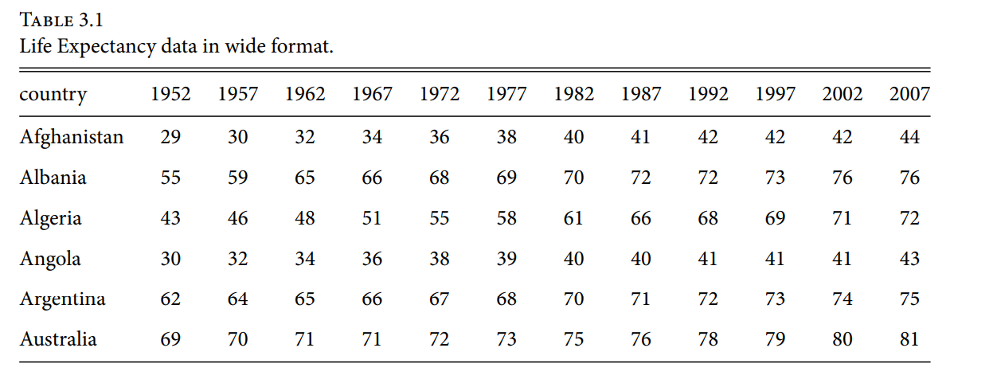
Wide Format
Healy, K(2017)

Slide 7
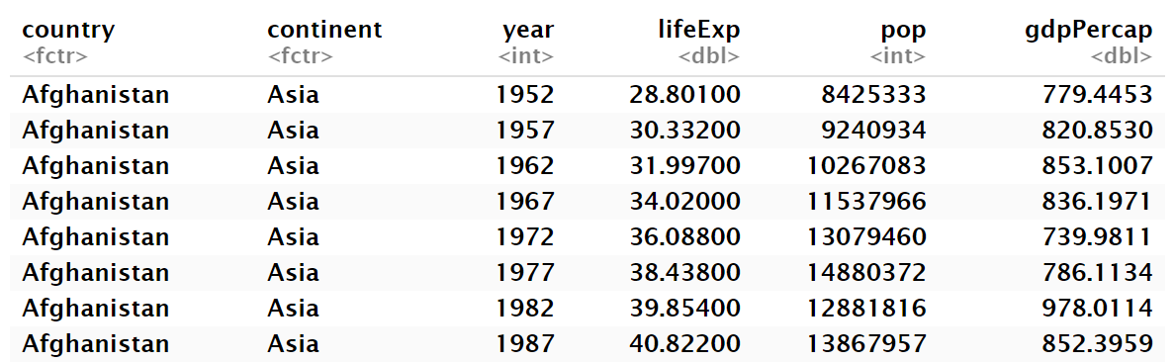
Long Format
Healy, K(2017)

Slide 8
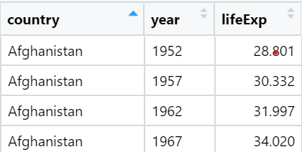
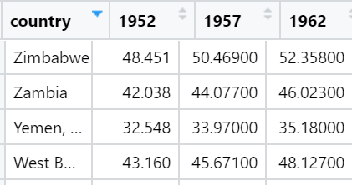
Melt and Dcast
Long to Wide
Wide to Long
library(gapminder) library(reshape2)
df <- select(gapminder, country, year, lifeExp)
#Long to wide format:
df_wide <- df %>% dcast(country~year)
#Wide to long format:
df_long <- melt(df_wide, variable.name="year",
value.name="lifeExp" )

Slide 9
Spread and Gather
Long to Wide
Wide to Long
library(gapminder) library(tidyverse)
df <- select(gapminder, country, year, lifeExp)
#Long to wide format:
df_wide_1 <- df %>% spread(year, lifeExp)
#Wide to long format:
df_long_1 <- gather(df_wide, key = "year", value ="lifeExp", 2:13)

Slide 10
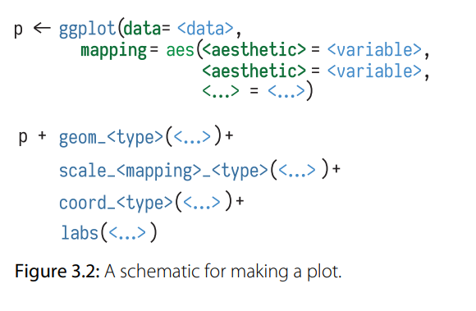
Grammar of Graphics
A Layered Grammar of Graphics:
https://www.uvm.edu/~ngotelli/Rscripts/wickham.2009.pdf
Data
Aesthetic Mapping
Geometric Object
Scales
Coordinate system
Faceting
Healy, K(2017)

Slide 11
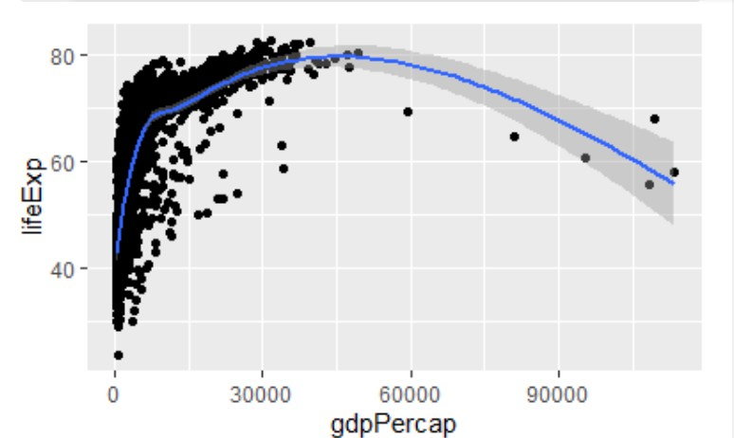
Example 1
library(tidyverse)
library(gapminder)
p <- ggplot(data = gapminder, mapping = aes(x = gdpPercap, y = lifeExp))
p + geom_point() + geom_smooth()
Healy, K(2017)

Slide 12
Data Visualization Foundations

Slide 13
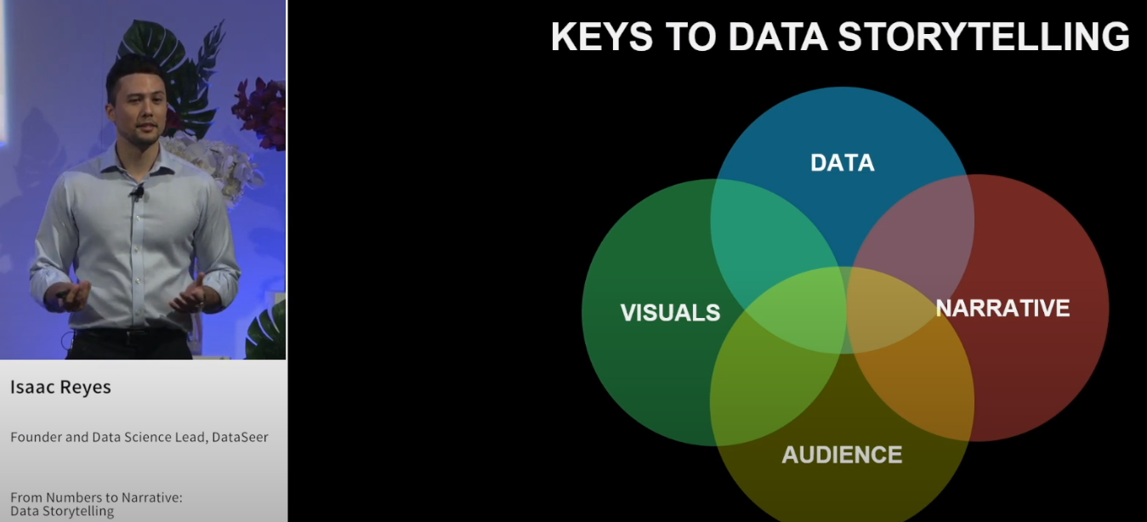
Isaac Reyes – Data Storytelling
Reyes, I (2018) From Numbers to Narrative: Data Storytelling. Open Data Science Conference Europe (ODSC).https://www.youtube.com/watch?v=MZ7cyrMecYY#t=0m01s

Slide 14

Isaac Reyes – Keys to Data Storytelling
Source the right data. Pull it together and pick the right metrics for stakeholders.
DATA
Visuals
Narrative
When is a chart appropriate? How to choose the right chart. Use a methodology for chart selection. What type of chart is right for given data?
Telling the story so that your audience understands and can take action!
Audience
Data Storytelling
Who our audience is and what they need to know.
Reyes, I (2018) From Numbers to Narrative: Data Storytelling. Open Data Science Conference Europe (ODSC).https://www.youtube.com/watch?v=MZ7cyrMecYY#t=0m01s

Slide 15
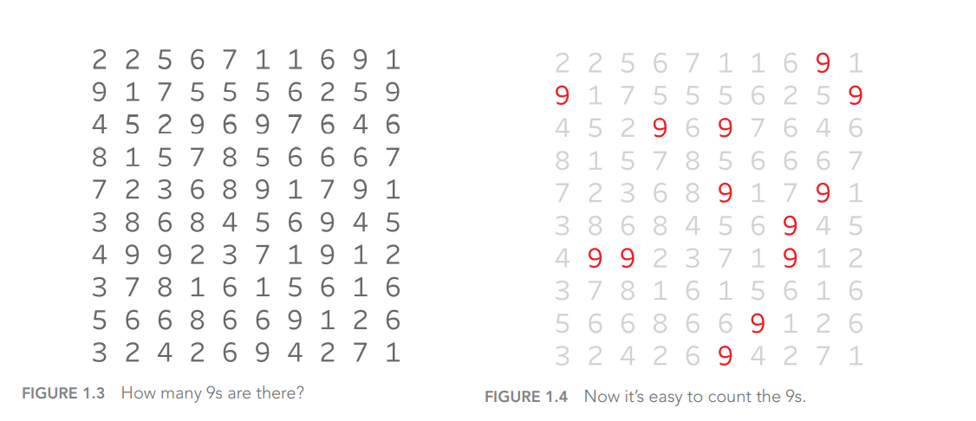
Numbers differ only in shape, and are high level symbols
You have to scan every number
But, the distinction of color is immediate (pre-attentive)
Only need to scan to count the 9’s
Wexler et al. (2017) p.6

Slide 16
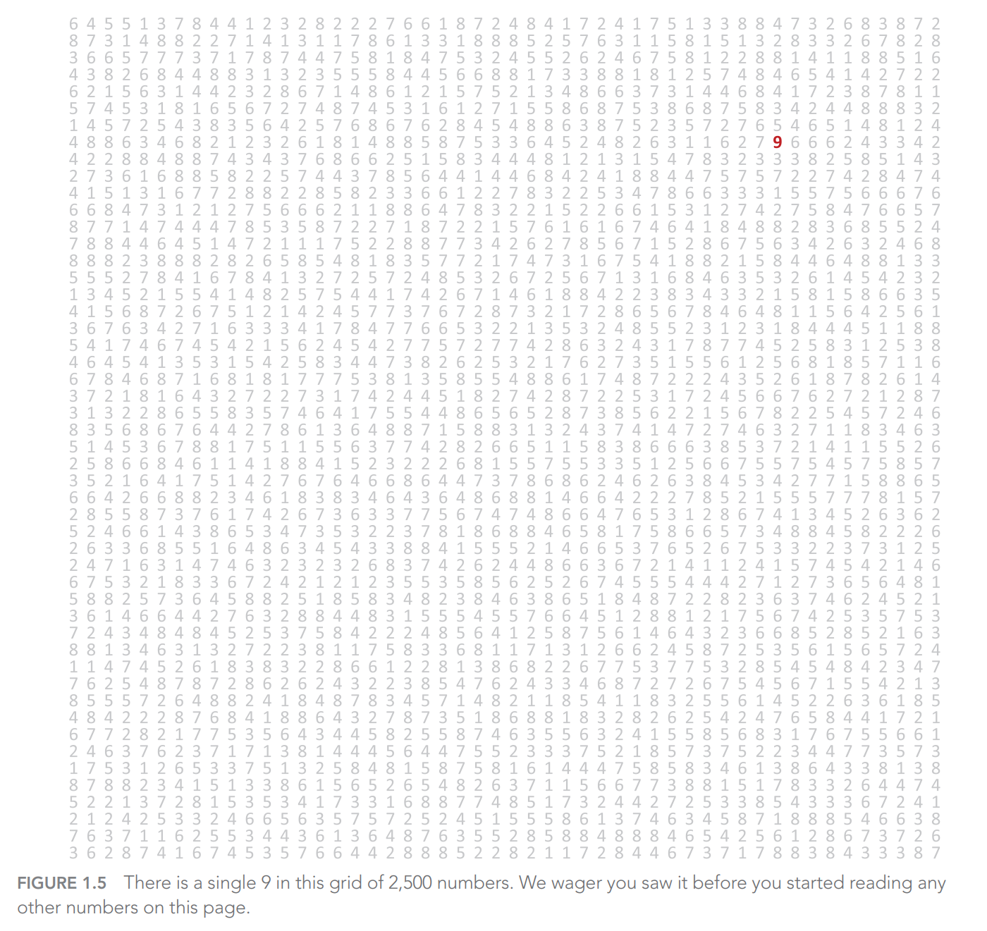
Wexler et al. (2017) p.7

Slide 17

Proximity
Image Source: Designer

Slide 18

Similarity
Image Source: Designer

Slide 19
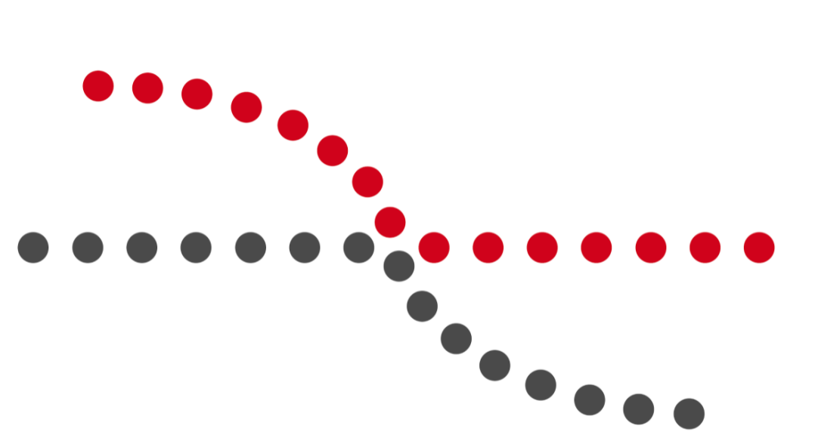
Continuity
Image Source: Designer

Slide 20

Closure

Slide 21
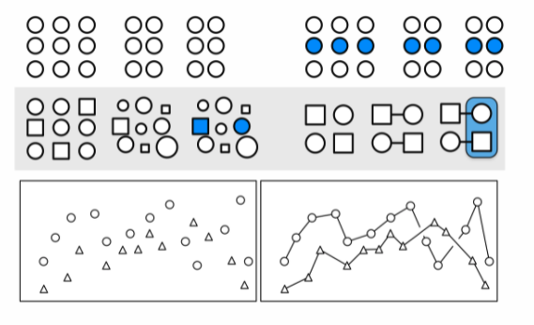
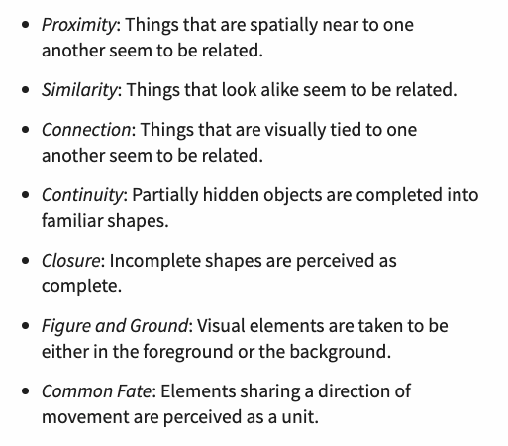
Gestalt Principles
Healy, K(2017)

Slide 22
How to visualize different types of plots with ggplot2

Slide 23
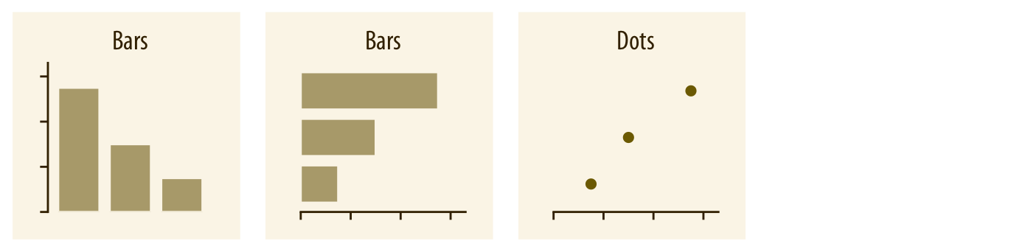
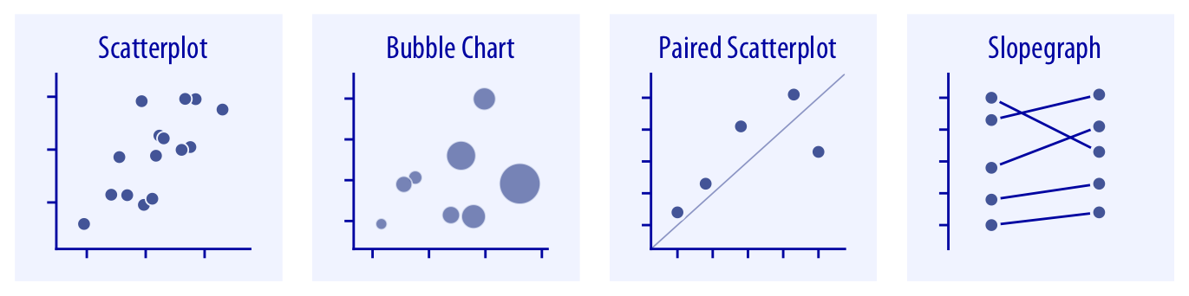
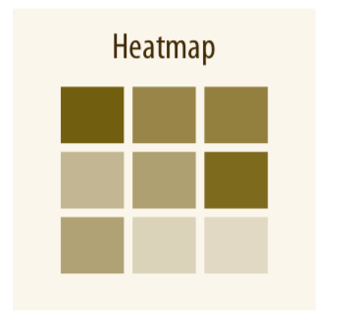
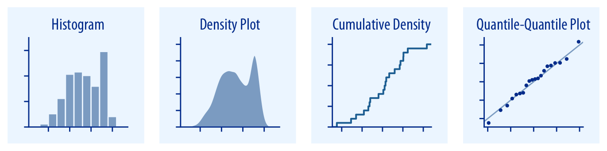
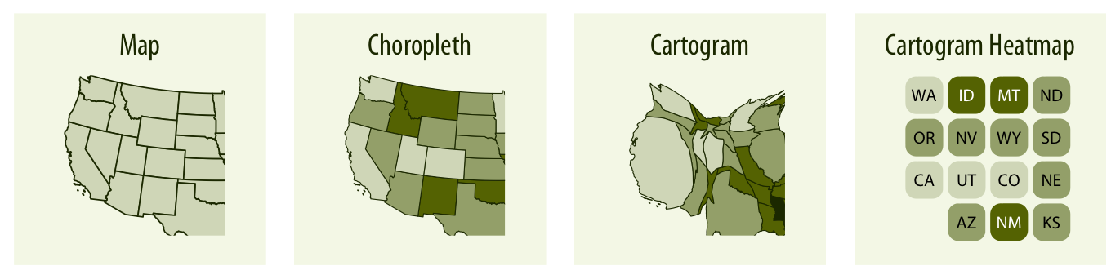
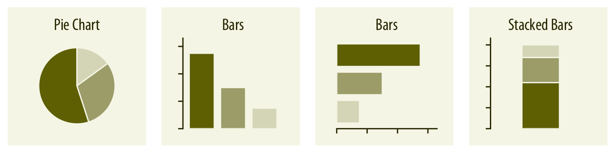
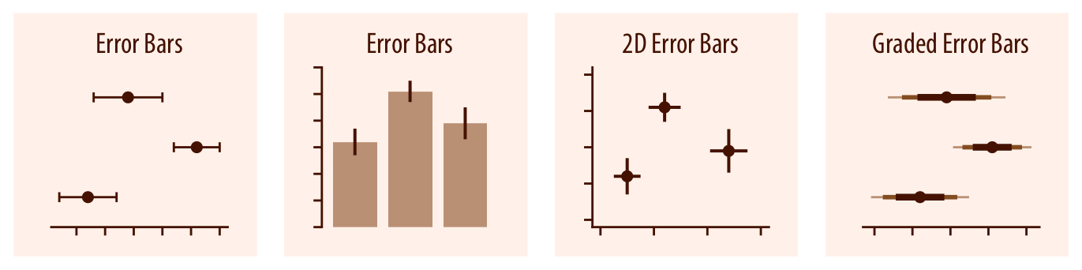
Plot types
Amounts
x–y relationships
Distributions
Geospatial
Proportions
Uncertainty
Healy, K(2017)

Slide 24
Example: Dataset PISA (2015)
We will use the 2015 administration of the OECD’s Programme for International Student Assessment (PISA).
PISA is a large-scale, international assessment that involves students, parents, teachers, and school principals from all over the world as participants. Every three years, PISA tests 15-year-old students from all over the world in reading, mathematics and science.
The tests are designed to learn how well the students master key subjects in order to be prepared for real-life situations in the adult world. It also looks for the best practice.

Slide 25
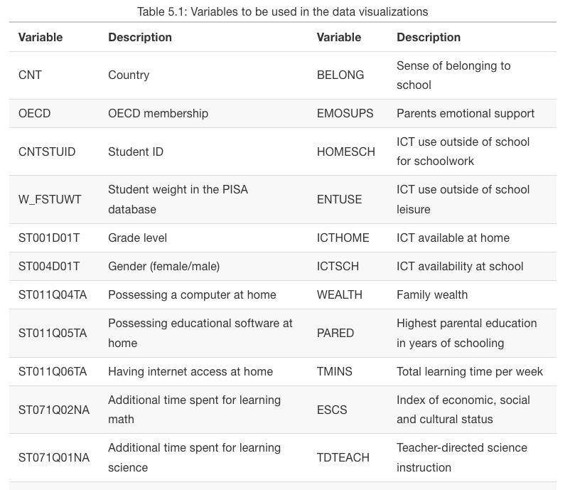
Bulut & Dejardins (2019)

Slide 26
Distribution

Slide 27
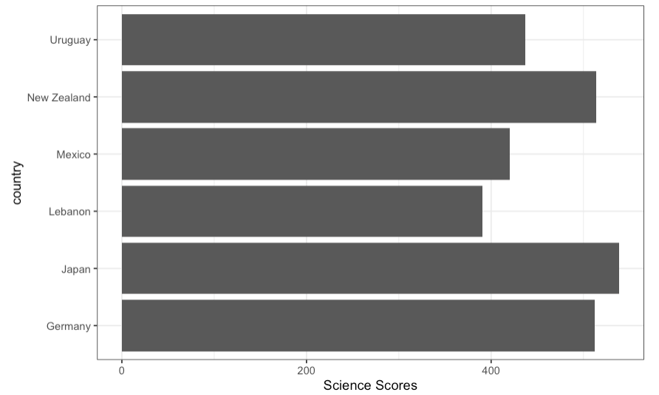
Science Scores Across Country and Region
Plotting the distribution of a continuous variable
#create a simple bar graph
science_summary <- dat[,
.(Science = mean(science, na.rm = TRUE), #average science scores by country
Freq = .N),
by = c("CNT")]
head(science_summary)
ggplot(data = science_summary,
mapping = aes(x = CNT, y = Science)) +
geom_bar(stat = "identity", position = "dodge") +
coord_flip() +
labs(x = "Country", y = "Science Scores") +
theme_bw()
Bulut & Dejardins (2019)
Notes:
QUESTION FOR CLASS: What elements of this graph help the viewer understand the data? How could someone have tweaked this graph to lie about the data?

Slide 28
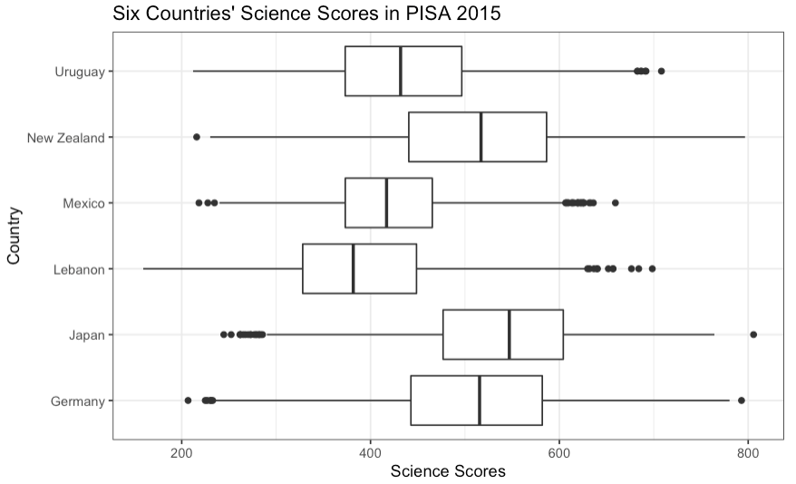
Science Scores Across Country and Region
Plotting the distribution of a continuous variable
#create a boxplot
ggplot(data = dat,
mapping = aes(x = CNT, y = science)) +
geom_boxplot() +
labs(x="Country", y="Science Scores", , title = "Six Countries' Science Scores in PISA 2015") +
coord_flip() +
theme_bw()
Bulut & Dejardins (2019)
Notes:
QUESTION FOR CLASS: What elements of this graph help the viewer understand the data? How could someone have tweaked this graph to lie about the data?

Slide 29
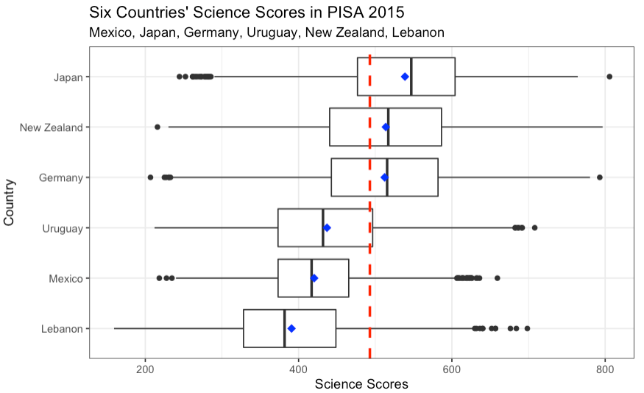
Science Scores Across Country and Region
Plotting the distribution of a continuous variable
#show the mean values in the boxplots
means <- dat[,
.(science = mean(science)),
by = CNT]
ggplot(data = dat,
mapping = aes(x = reorder(CNT, science), y = science)) +
geom_boxplot() +
stat_summary(fun.y = mean, colour = "blue", geom = "point",
shape = 18, size = 3) + #mean score by countries
labs(x="Country", y="Science Scores", title = "Six Countries' Science Scores in PISA 2015",
subtitle = "Mexico, Japan, Germany, Uruguay, New Zealand, Lebanon"
) +
coord_flip() +
geom_hline(yintercept = 493, linetype="dashed", color = "red", size = 1) + #refence line-the average score across 6 countries
theme_bw()
Bulut & Dejardins (2019)

Slide 30
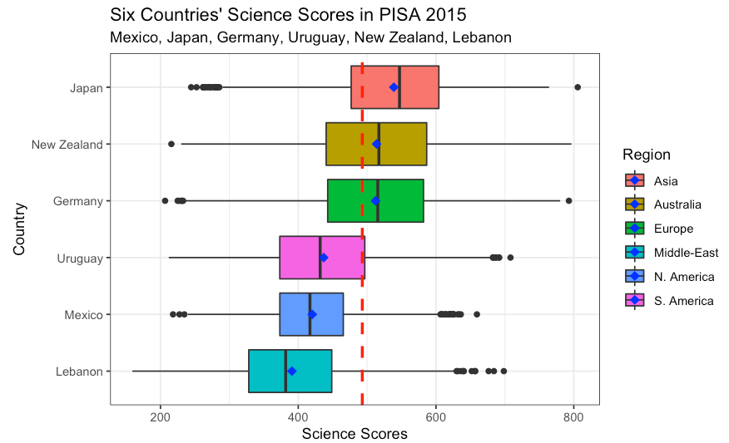
Science Scores Across Country and Region
Plotting the distribution of a continuous variable
#add some colors to our figure based on the region
ggplot(data = dat,
mapping = aes(x = reorder(CNT, science), y = science, fill = Region)) +
geom_boxplot() +
stat_summary(fun.y = mean, colour = "blue", geom = "point",
shape = 18, size = 3) + #mean score by countries
labs(x="Country", y="Science Scores", title = "Six Countries' Science Scores in PISA 2015",
subtitle = "Mexico, Japan, Germany, Uruguay, New Zealand, Lebanon") +
coord_flip() +
geom_hline(yintercept = 493, linetype="dashed", color = "red", size = 1) +
theme_bw()
Bulut & Dejardins (2019)

Slide 31
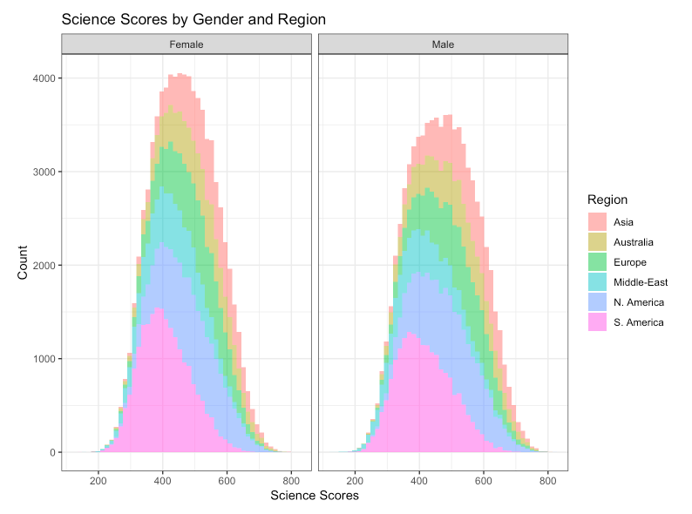
Science Scores by Gender and Region
Plotting the distribution of a continuous variable
ggplot(data = dat,
mapping = aes(x = science, fill = Region)) +
geom_histogram(alpha = 0.5, bins = 50) +
labs(x = "Science Scores", y = "Count",
title = "Science Scores by Gender and Region") +
facet_grid(. ~ sex) +
theme_bw()
Bulut & Dejardins (2019)

Slide 32
Relationship

Slide 33
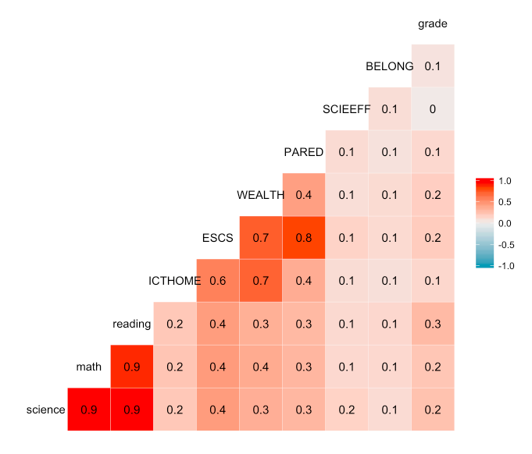
Look for Correlated Variables
By creating a correlation matrix plot
ggcorr(data = dat[,.(science, math, reading, ICTHOME, ESCS,
WEALTH, PARED, SCIEEFF, BELONG, grade)],
method = c("pairwise.complete.obs", "pearson"),
label = TRUE, label_size = 4)
Bulut & Dejardins (2019)
Notes:
QUESTION FOR CLASS: According to reyes, what would be a better title for this graph? How could we improve the legend?

Slide 34
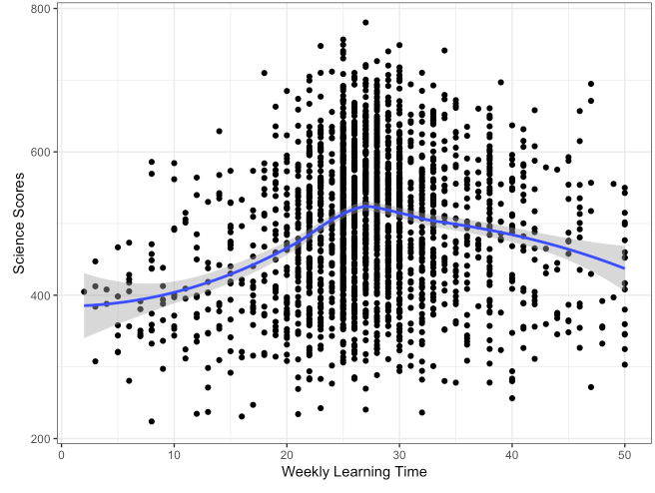
Learning Time and Science Scores
Plotting the conditional (x-y) relationship of continuous variables
p1 <- ggplot(data = dat_small,
mapping = aes(x = learning, y = science)) +
geom_point() +
geom_smooth(method = "loess") +
labs(x = "Weekly Learning Time", y = "Science Scores") +
theme_bw()
# Replace "histogram" with "boxplot" or "density" for other types
ggMarginal(p1, type = "histogram")
Bulut & Dejardins (2019)
Notes:
QUESTION FOR CLASS: According to reyes, what would be a better title for this graph? How could we improve the legend?

Slide 35
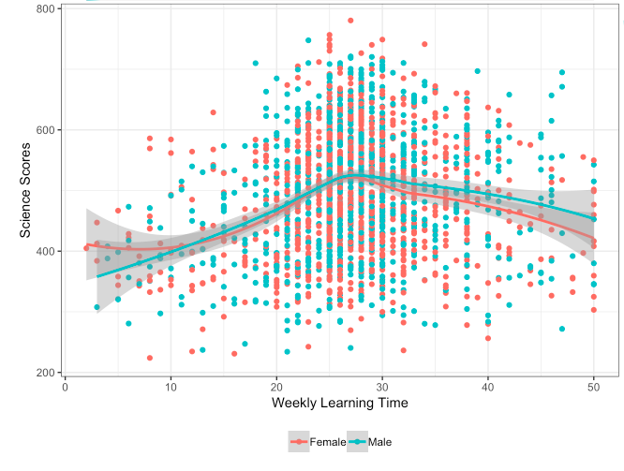
Learning Time and Science Scores by Gender
Plotting the conditional (x-y) relationship
p2 <- ggplot(data = dat_small,
mapping = aes(x = learning, y = science,
colour = sex)) +
geom_point() +
geom_smooth(method = "loess") +
labs(x = "Weekly Learning Time", y = "Science Scores") +
theme_bw() +
theme(legend.position = "bottom",
legend.title = element_blank())
p2
Bulut & Dejardins (2019)
Notes:
QUESTION FOR CLASS: According to reyes, what would be a better title for this graph? How could we improve the legend?

Slide 36
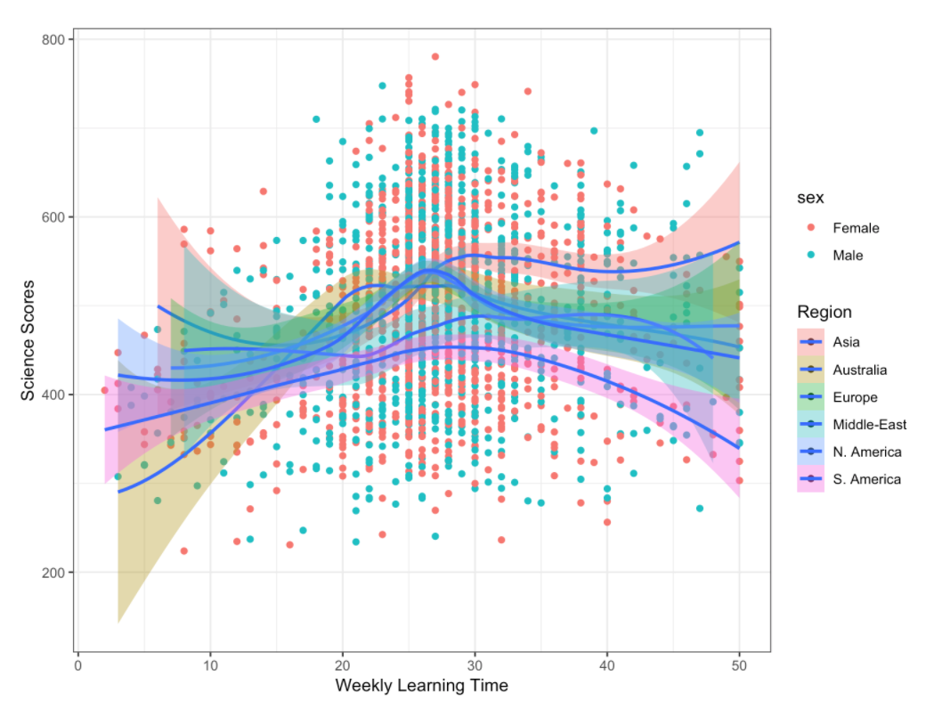
Learning Time and Science Scores by Gender and Region
Plotting the conditional (x-y) relationship
ggplot(data = dat_small,
mapping = aes(x = learning, y = science, fill = Region)) +
geom_point(aes(colour = sex)) +
geom_smooth(method = "loess") +
labs(x = "Weekly Learning Time", y = "Science Scores") +
theme_bw()
Bulut & Dejardins (2019)

Slide 37
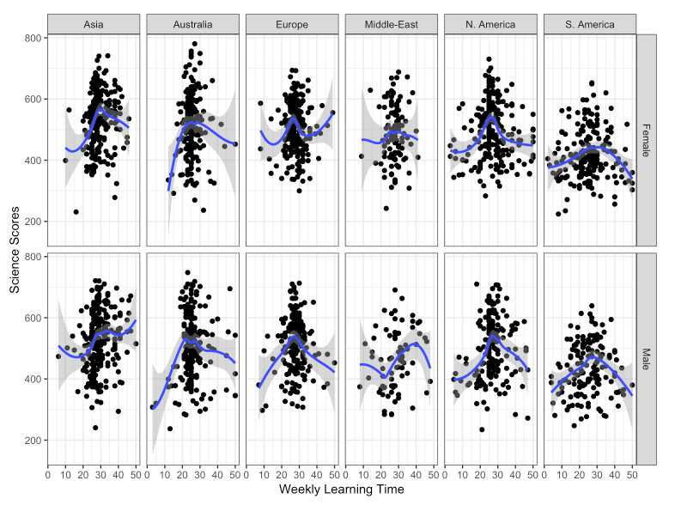
Learning Time and Science Scores by Gender and Region
Plotting the conditional (x-y) relationship
ggplot(data = dat_small,
mapping = aes(x = learning, y = science)) +
geom_point() +
geom_smooth(method = "loess") +
labs(x = "Weekly Learning Time", y = "Science Scores") +
theme_bw() +
theme(legend.title = element_blank()) +
facet_grid(sex ~ Region)
Bulut & Dejardins (2019)

Slide 38
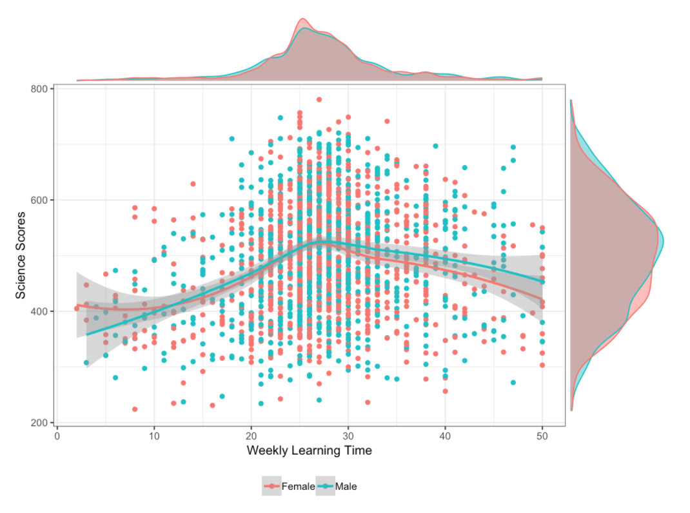
Learning Time and Science Scores
Plotting the conditional (x-y) relationship and marginal density of continuous variables
p2 <- ggplot(data = dat_small,
mapping = aes(x = learning, y = science,
colour = sex)) +
geom_point() +
geom_smooth(method = "loess") +
labs(x = "Weekly Learning Time", y = "Science Scores") +
theme_bw() +
theme(legend.position = "bottom",
legend.title = element_blank())
ggMarginal(p2, type = "density", groupColour = TRUE, groupFill = TRUE)
Bulut & Dejardins (2019)
Notes:
QUESTION FOR CLASS: According to reyes, what would be a better title for this graph? How could we improve the legend?

Slide 39
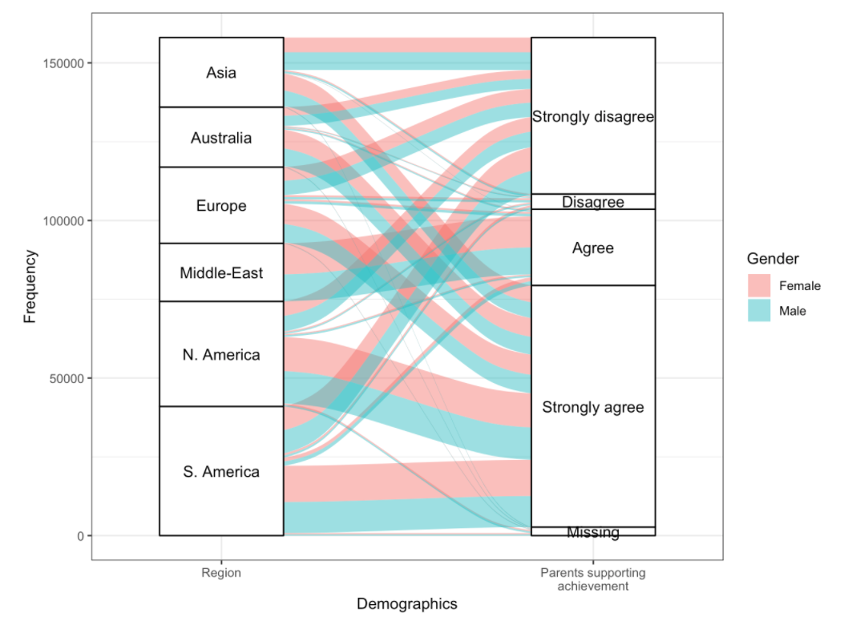
Parental Support Across Countries
Visualizing categorical & ordinal variables using an alluvial plot
dat_alluvial <- dat[,
.(Freq = .N),
by = c("Region", "sex", "ST123Q02NA")
][,
ST123Q02NA := as.factor(ifelse(ST123Q02NA == "", "Missing", ST123Q02NA))
]
levels(dat_alluvial$ST123Q02NA) <- c("Strongly disagree", "Disagree", "Agree",
"Strongly agree", "Missing")
head(dat_alluvial)
ggplot(data = dat_alluvial,
aes(axis1 = Region, axis2 = ST123Q02NA, y = Freq)) +
scale_x_discrete(limits = c("Region", "Parents supporting\nachievement"),
expand = c(.1, .05)) +
geom_alluvium(aes(fill = sex)) +
geom_stratum() +
geom_text(stat = "stratum", label.strata = TRUE) +
labs(x = "Demographics", y = "Frequency", fill = "Gender") +
theme_bw()
Bulut & Dejardins (2019)
Notes:
An alluvial plot can be used to summarize relationships between multiple categorical variables. In the following example, we use region (Region), gender (sex), and a survey item regarding whether parents support educational efforts and achievements

Slide 40
Revisiting Learning Time and Science Scores
ggplot(data = dat_small,
mapping = aes(x = learning, y = science, fill = Region)) +
geom_point(aes(colour = sex)) +
geom_smooth(method = "loess") +
labs(x = "Weekly Learning Time", y = "Science Scores") +
theme_bw()
Can we make this color-blind accessible?
Bulut & Dejardins (2019)

Slide 41
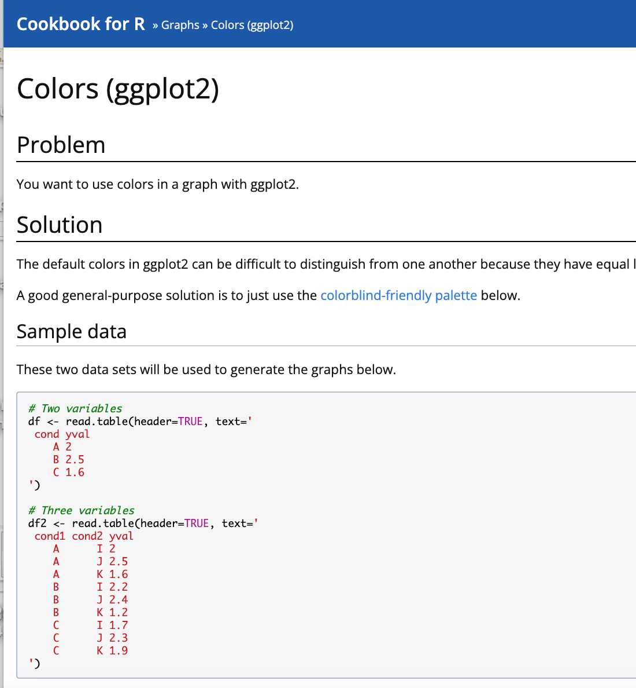
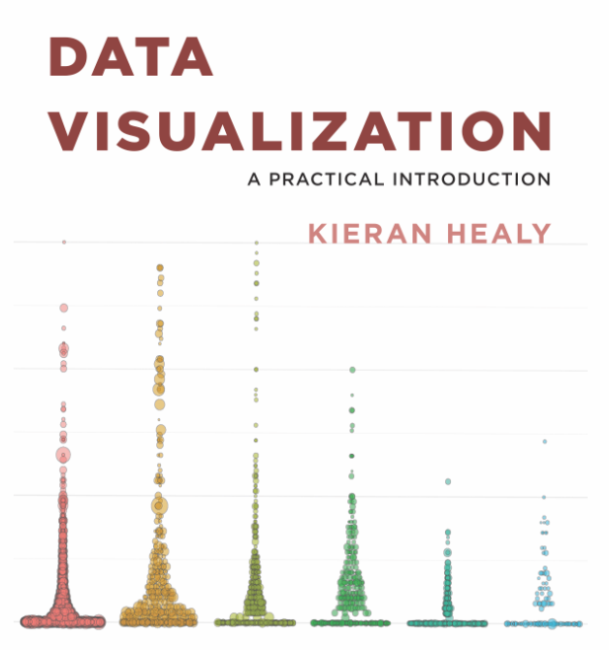

http://www.cookbook-r.com/Graphs/Colors_(ggplot2)/

Slide 42
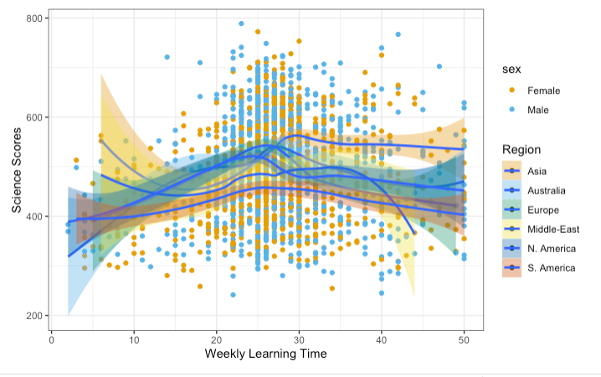
cbPalette <- c("#E69F00", "#56B4E9", "#009E73", "#F0E442", "#0072B2", "#D55E00", "#CC79A7")
ggplot(data = dat_small,
mapping = aes(x = learning, y = science, fill = Region)) +
geom_point(aes(colour = sex) ) +
geom_smooth(method = "loess") +
labs(x = "Weekly Learning Time", y = "Science Scores") +
theme_bw()+
scale_fill_manual(values=cbPalette)+
scale_colour_manual(values=cbPalette)

Slide 43
Interactive Plot

Slide 44
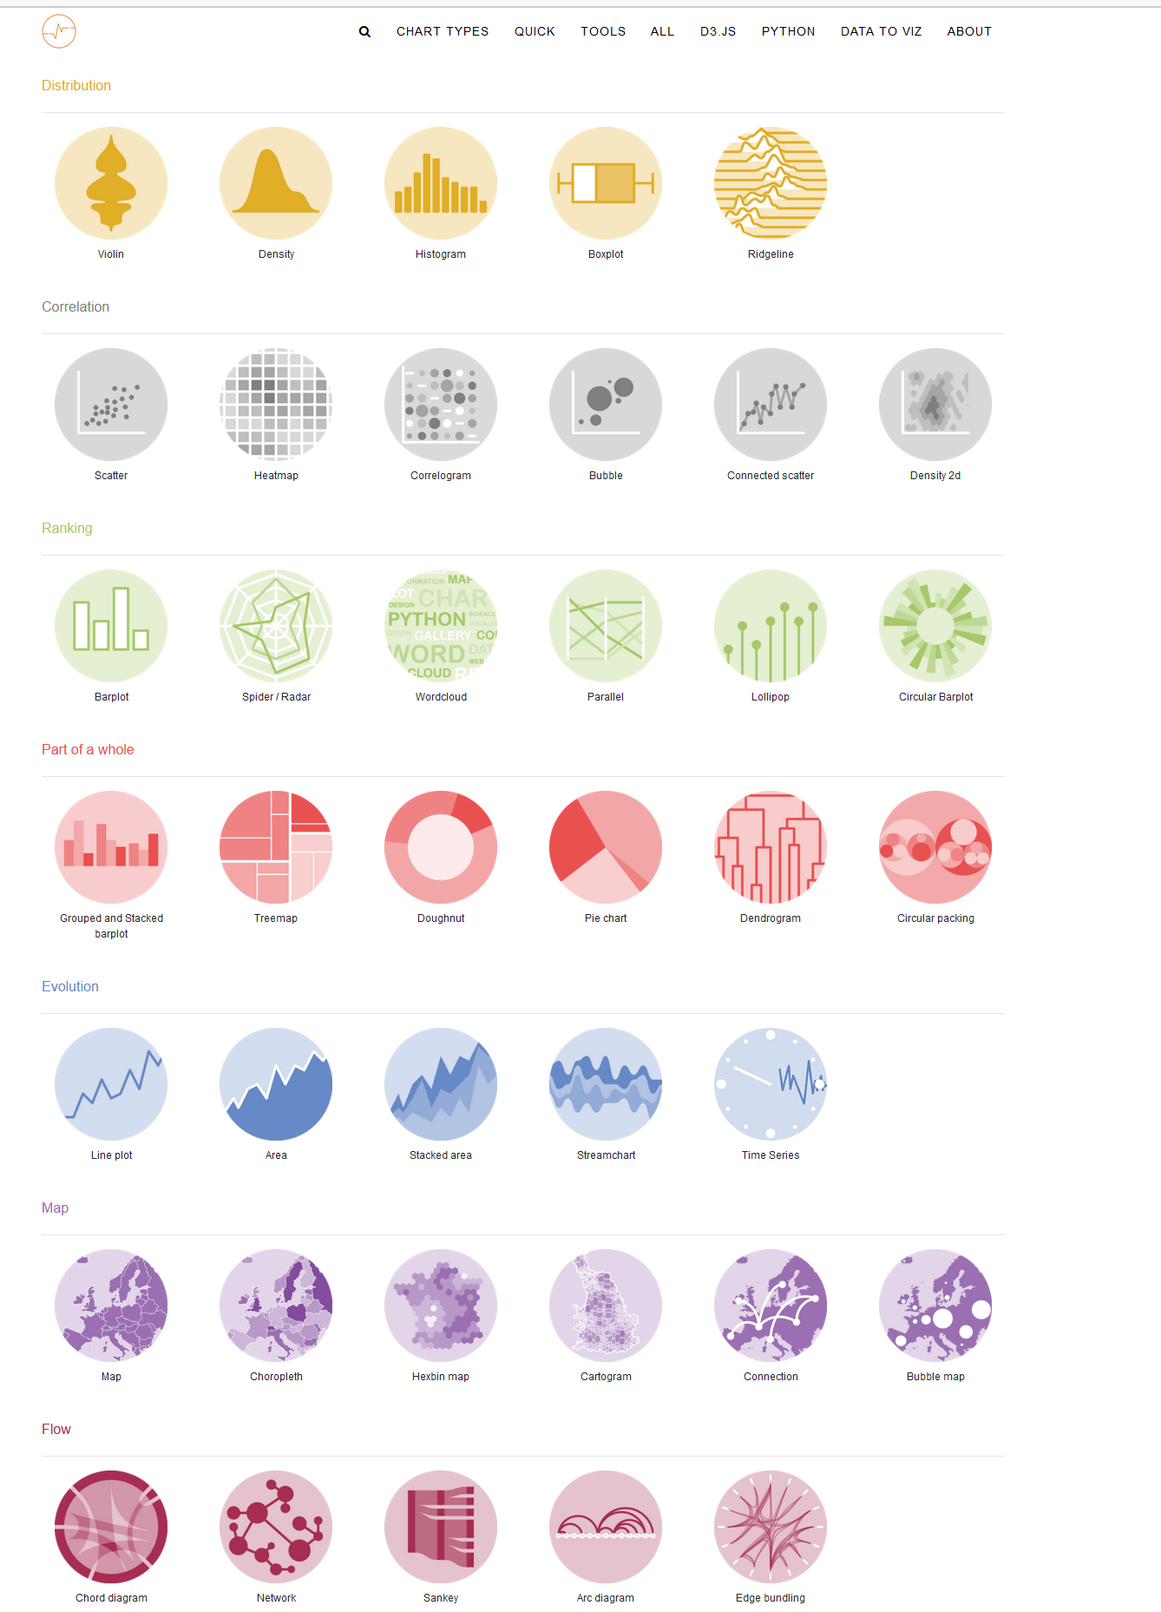

For more information
https://www.r-graph-gallery.com/index.html

Slide 45
Quick Tips

Slide 46
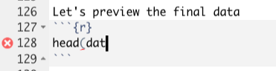
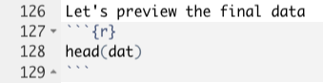
Make sure parentheses are balanced and that every opening “(” has a corresponding closing “)”.

Slide 47
2. Make sure you complete your expressions.
plot2 <-
> plot2 <-
Error: Incomplete expression: plot2 <-
+
+
+
plot2 <- c(1, 2, 3)
plot2
> plot2 <- c(1,2,3)
> plot2
[1] 1 2 3

Slide 48
3. Make sure your + character goes at the end of the line, and not the beginning.
ggplot(data = mpg, aes(x = displ, y = hwy))
+ geom_point()
> ggplot(data = mpg)
> + geom_point(mapping = aes(x = displ, y = hwy))
Error: Cannot use `+.gg()` with a single argument. Did you accidentally put + on a new line?
ggplot(data = mpg, aes(x = displ, y = hwy)) +
geom_point()

Slide 49

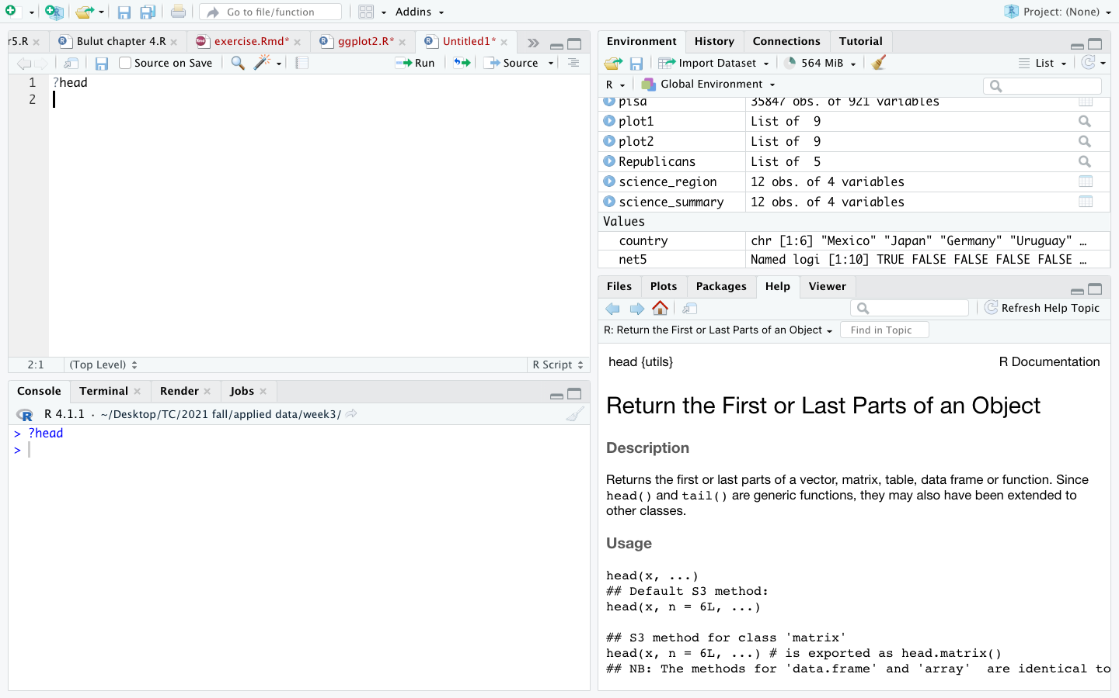

4. ?function
5. Google DuckDuckGo it!

Slide 50
Q & A

Slide 51
References
Reyes, I (2018) From Numbers to Narrative: Data Storytelling. Open Data Science Conference Europe (ODSC). https://www.youtube.com/watch?v=MZ7cyrMecYY#t=0m01s
Wexler, S., Shaffer, J., Cotgreave, A. (2017) The Big Book of Dashboards: Visualizing Your Data Using Real-World Business Scenarios. Wiley. ISBN: 978-1119282716
Bulut & Dejardins (2019) Exploring, Visualizing, and Modeling Big Data in R. Chapter 5- Visualizing Big Data, pages 33-62. https://okanbulut.github.io/bigdata/
Healy, K. (2017) Data Visualization: A Practical Introduction. Chapter 2-6, p. 32-172. https://socviz.co/

